Slide 1
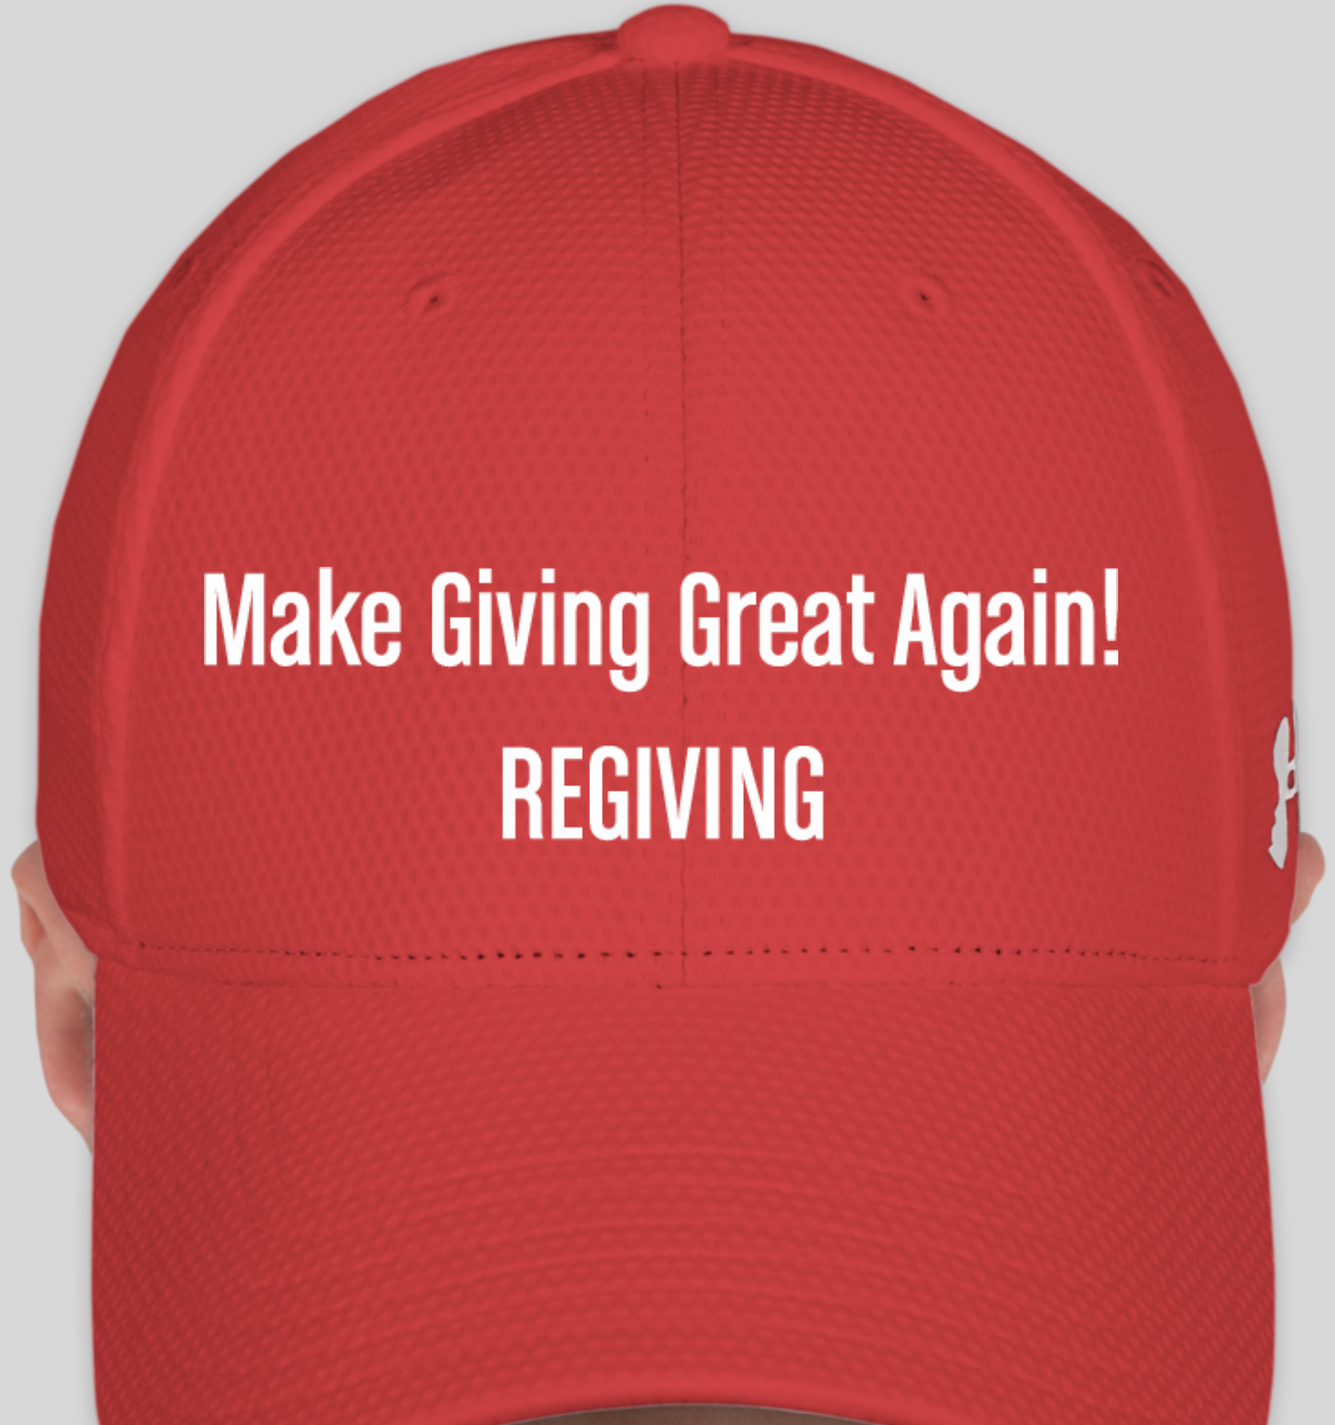
Notes:
In the 2017 fiscal year.. 216.76M iPhones, 200M Samsungs, 25M Cameras

Slide 2
Just BOUGHT SOMETHING NEW?
GIVE AWAY THE OLD ONE!
REGIVING….
Notes:
In the 2017 fiscal year.. 216.76M iPhones, 200M Samsungs, 25M Cameras

Slide 3



Just BOUGHT SOMETHING NEW?
GIVE AWAY THE OLD ONE!
REGIVING….
Notes:
In the 2017 fiscal year.. 216.76M iPhones, 200M Samsungs, 25M Cameras

Slide 4
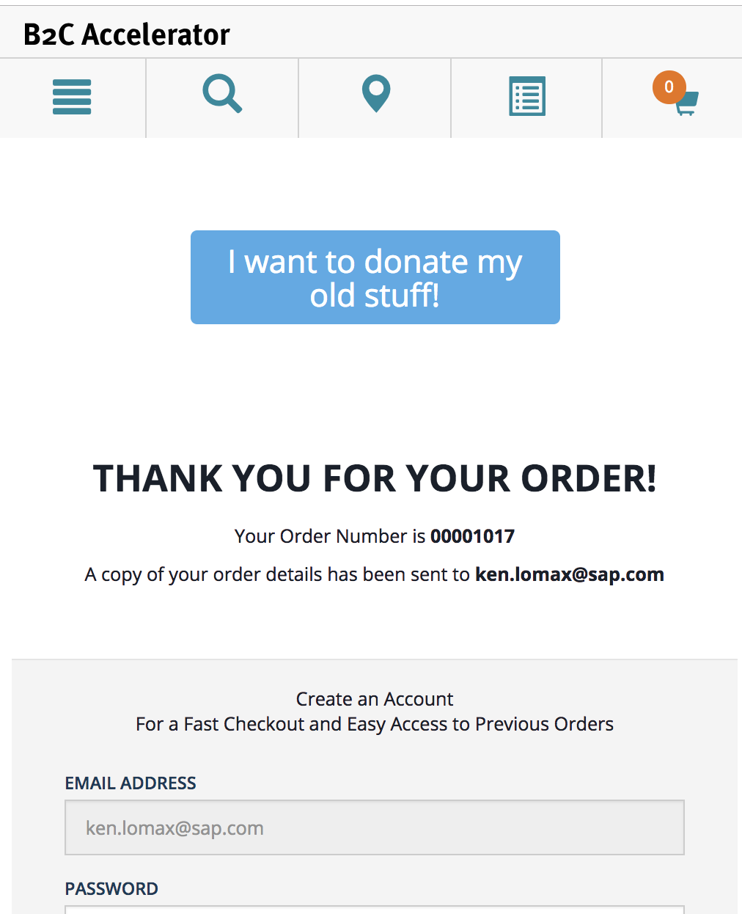
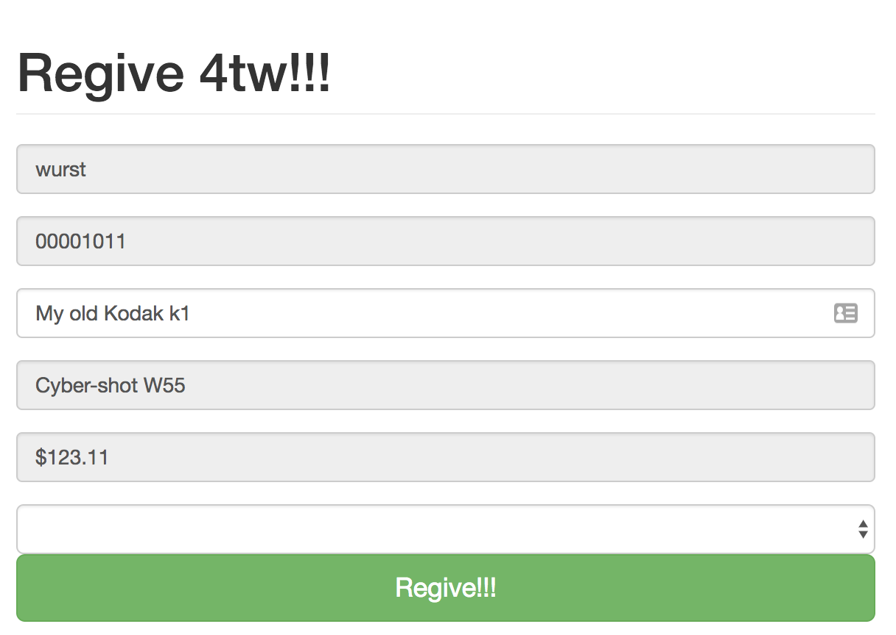
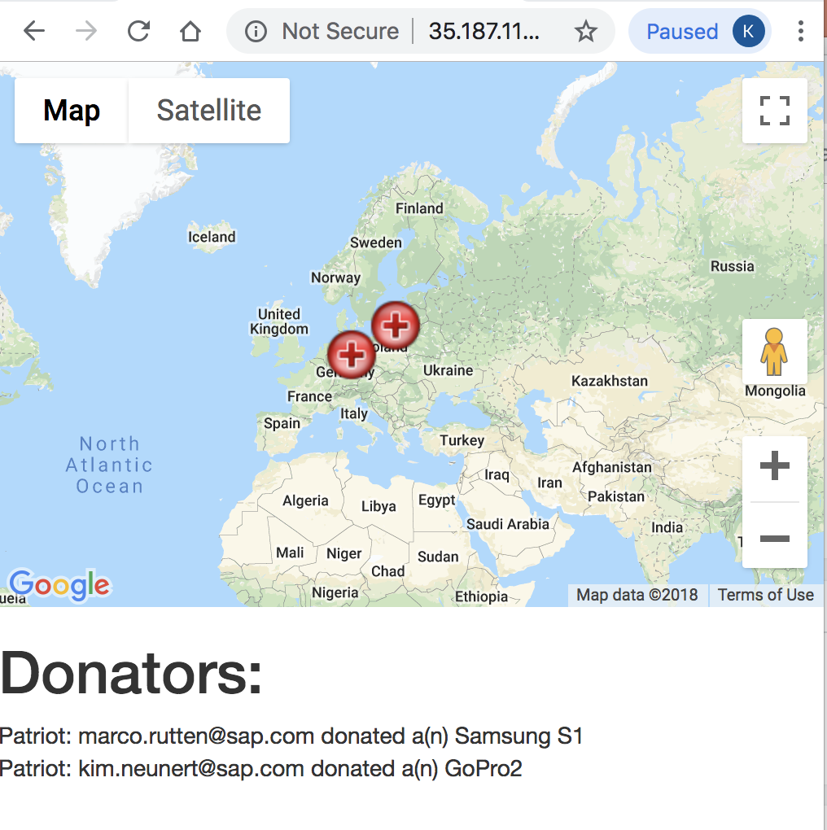

Slide 5
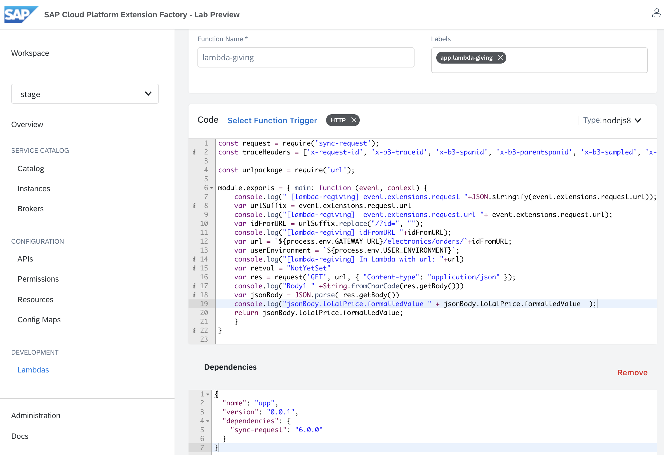
Name (Kirsten)
SmartEdit and Javascript (Jochen)
Python, TinyDB (Kim)
Map App in NodeJS on GCP (Ken)
Python calls Lambda &
Lamda calls OCC to get price

Slide 6
Lessons Learned, how to …
call Kyma Lambdas directly to call OCC
code Python Apps
use TinyDB
use SmartEdit to add buttons and logic to Storefront
use kubectl rollout status
code with Kyma

Slide 7
Just BOUGHT SOMETHING NEW?
GIVE AWAY THE OLD ONE!
REGIVING….

